Slide 1
Presenting the downward motion of a simple Yo-Yo
~By Bastain Slater-Tyler

Slide 2
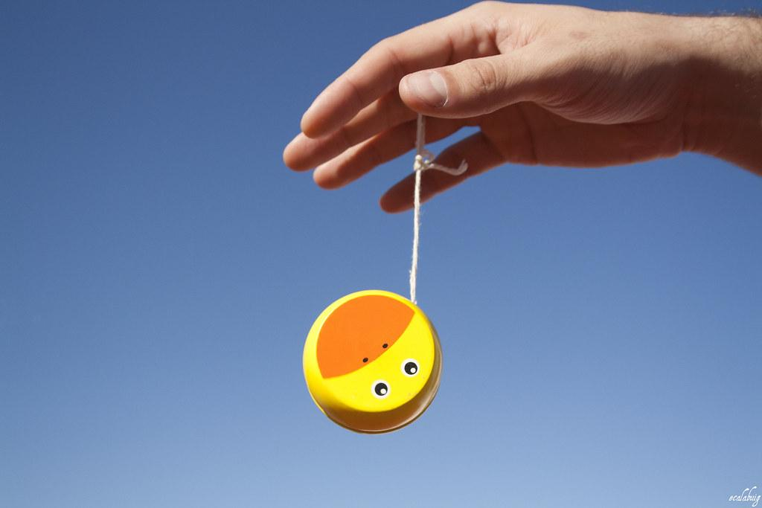
Goals of the project
How does a primitive yo-yo behave when let go from rest to some distance?
What factors most affect the spin rate of a simple yo-yo?

Slide 3
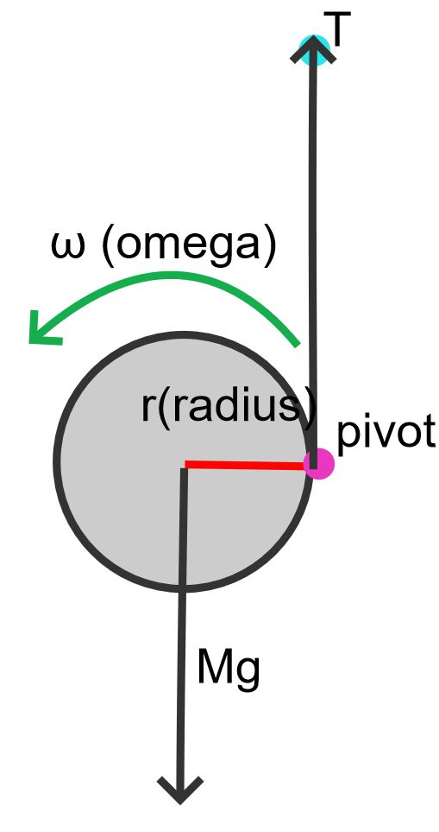



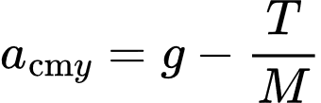
Basic Diagram of Downward Motion
Sum of forces
Net forces acting on yoyo
Force equation

Slide 4

Basic Diagram of Downward Motion
Torque from tension

Slide 5

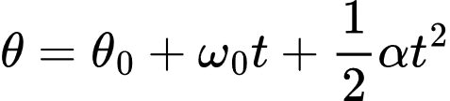

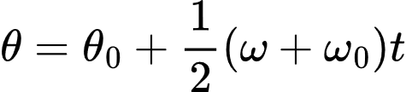
Rotational Kinematic Equations

Slide 6

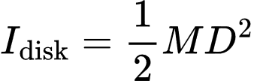
Theory - Inertia Formulas

Slide 7


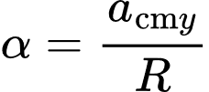
Theory - Angular Formula
Take derivative
Solve for alpha

Slide 8


Theory - Torques

Slide 9

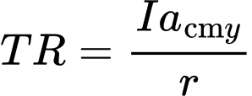
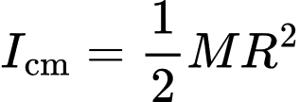
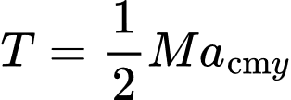
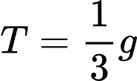
Theory - Tension Calculation

Slide 10
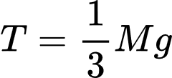
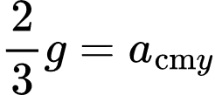
Theory - Acceleration Formulas

Slide 11

Glowscript Simulation
In glowscript I was able to get good results for the simulation.
Positives:
-Data and graphs
-Trails are nice
-Easy to set up basic sim
Negatives:
-Camera controls
-UI
-Difficult to create manage large scripts

Slide 12

Switch to Godot
What is Godot?
Why switch?

Slide 13
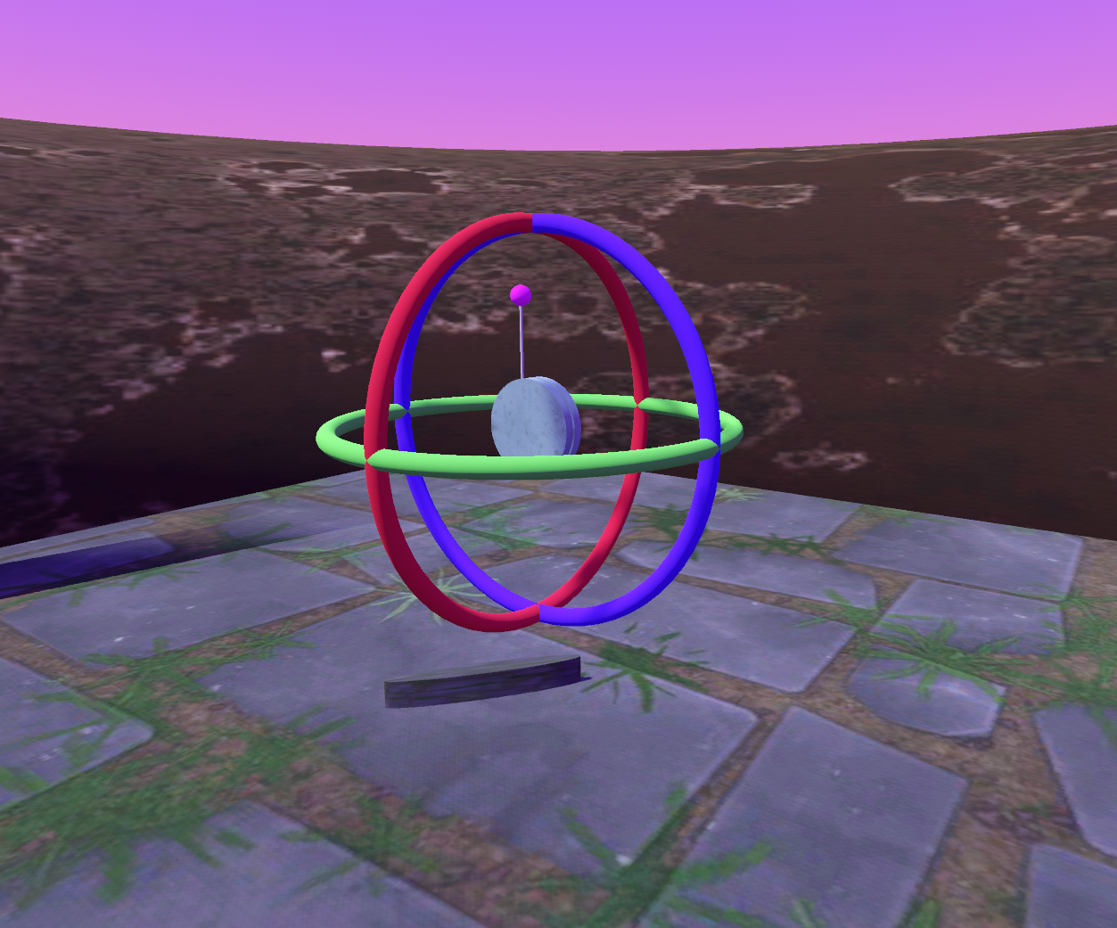
Test Trial Information
Trials for displayed graphs:
Constants Disk Mass = 0.120(kg)
Axle Mass = 0.000(kg)
Distance Fallen Over = 10.0 (m)
Treated as non-slipping, string of negligible mass, and as an idealized primitive Yo-Yo experiencing no air resistance or friction

Slide 14
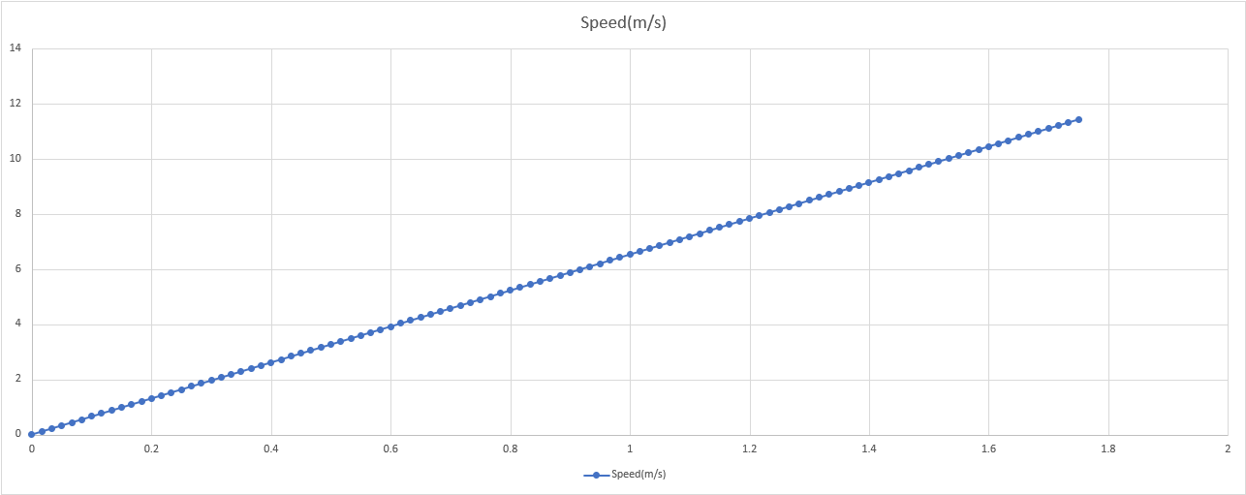
Speed vs Time

Slide 15
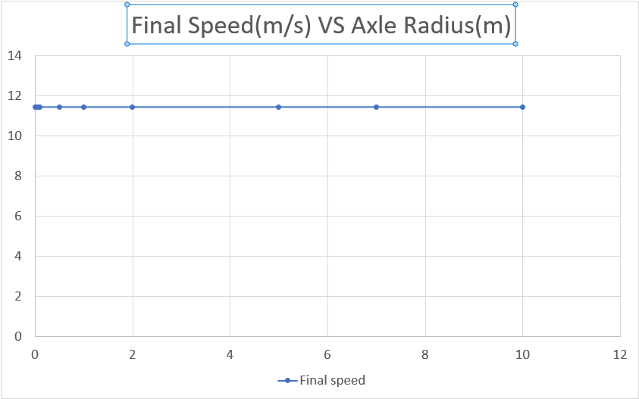
Final Speed vs Axle(disk)Radius
Radius Trials | Radius(m) | Final speed(m/s)
1 | 0.01 | 11.43
2 | 0.05 | 11.43
3 | 0.1 | 11.43
4 | 0.5 | 11.43
5 | 1 | 11.43
6 | 2 | 11.43
7 | 5 | 11.43
8 | 7 | 11.43
9 | 10 | 11.43
Constant Values Across Trials
Disk Mass = 0.120(kg)
Axle Mass = 0.001(kg)
Axle Radius = 0.001(m)
Distance Fallen Over = 10.0 (m)

Slide 16
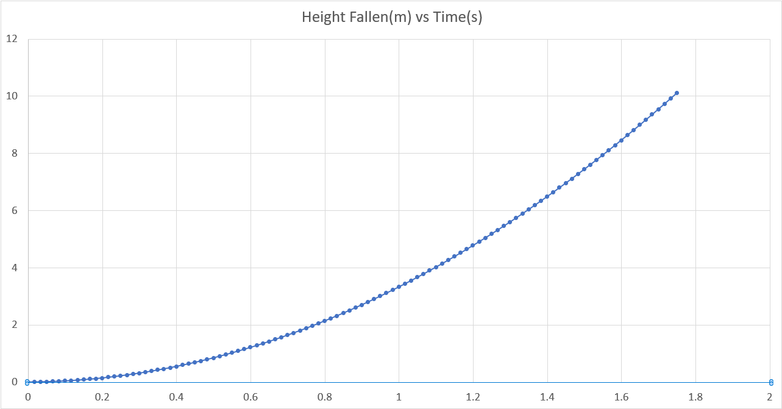
Final Speed vs Height
Final speed increases quadratically as it descends

Slide 17
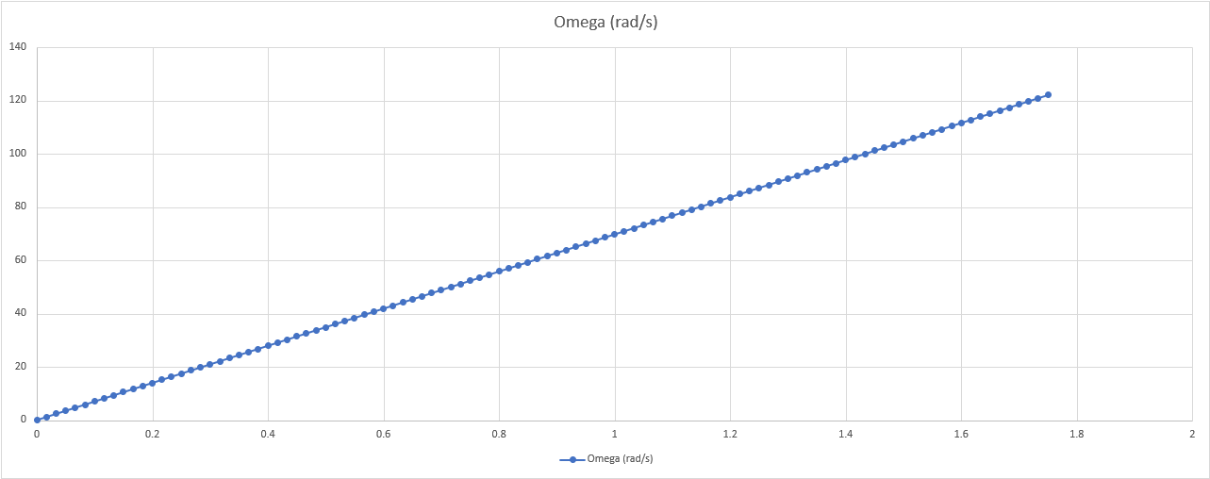
Omega vs Time
Omega increases linearly along time

Slide 18
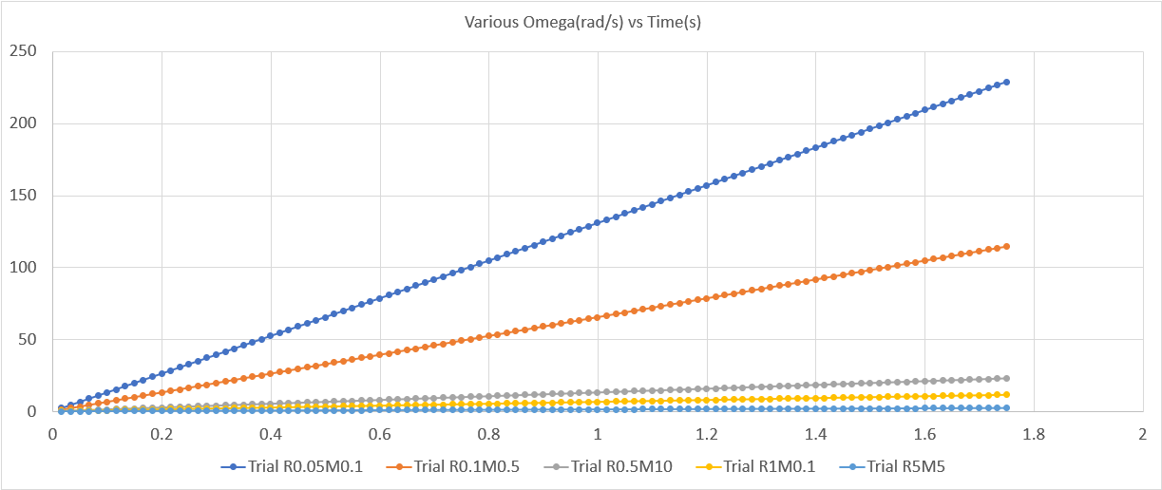
Omega vs Time
R0.05 -> disk radius 0.5(m)
M0.1 -> disk mass 0.1(kg)
Increased radius's result in rapid decreases in omega

Slide 19
Free camera
Simple Free-Look Camera 1.0 Scripts 4.0 Community
Submitted by user aloivmada; MIT; 2023-02-19

Slide 20
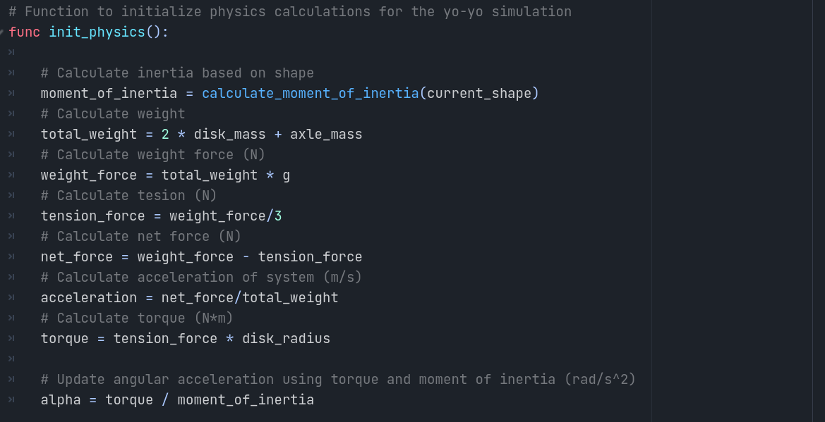
Code Overview: Initialize

Slide 21
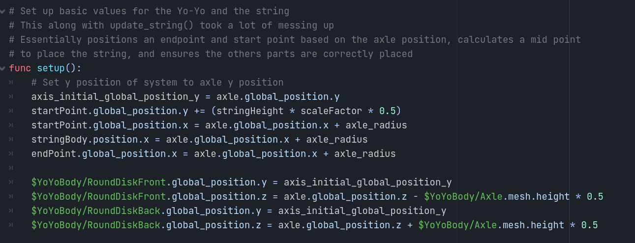
Code Overview: Setup

Slide 22
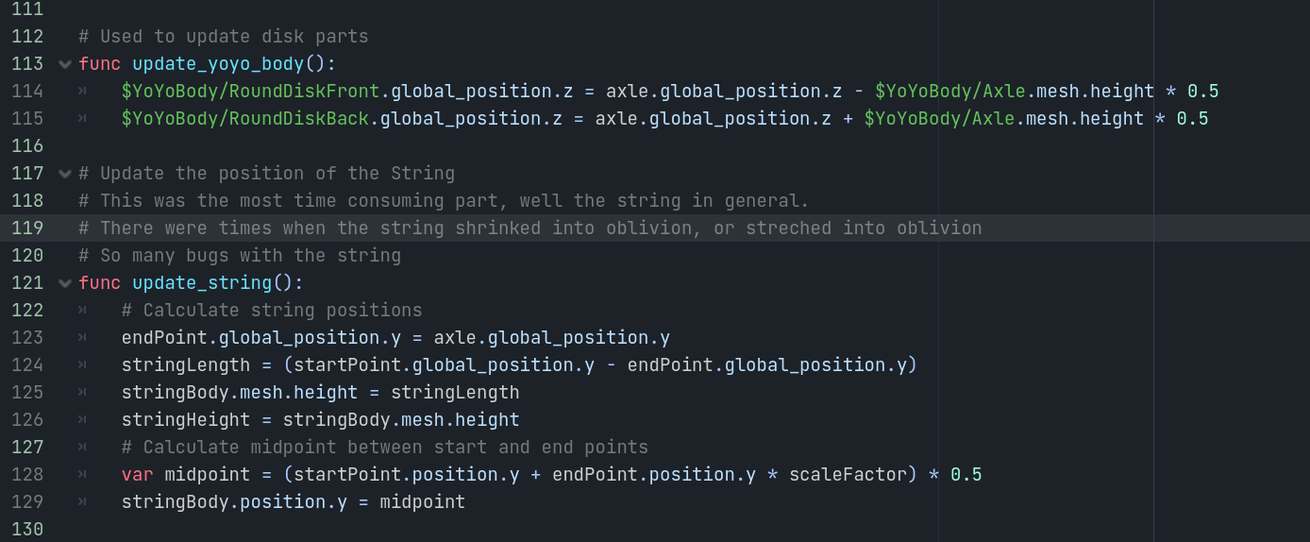
Code Overview: Update string/disks

Slide 23
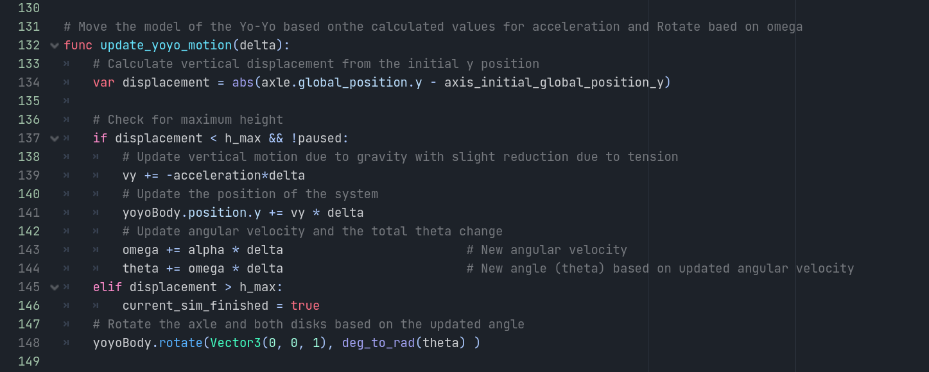
Code Overview: Simulate Motion

Slide 24
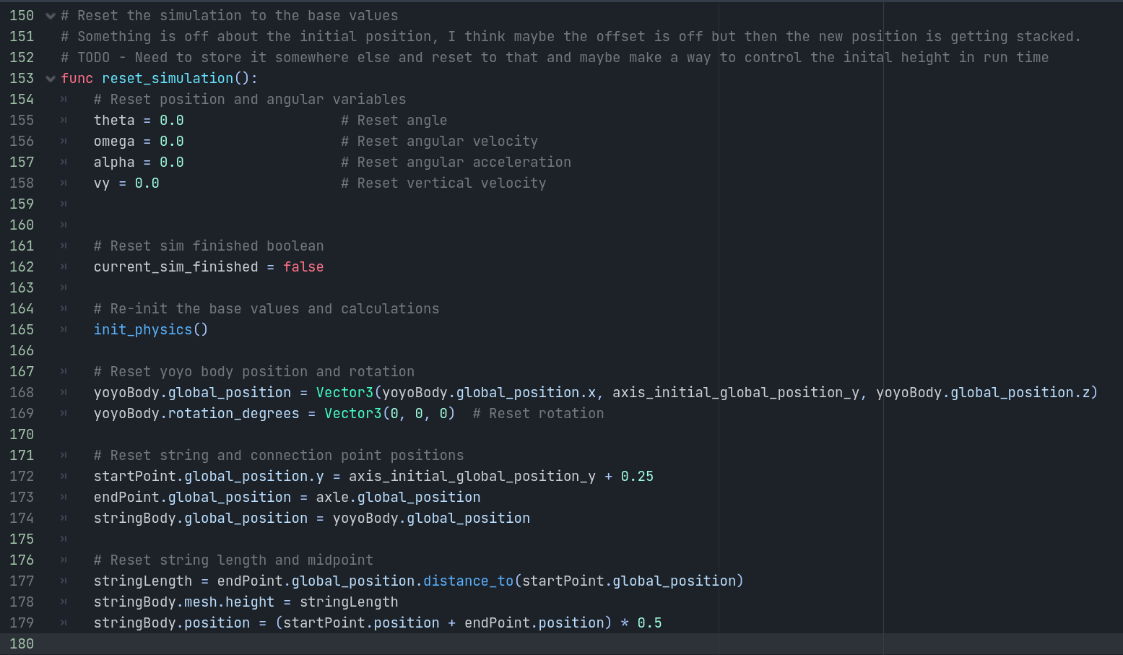
Code Overview: Reset parameters

Slide 25
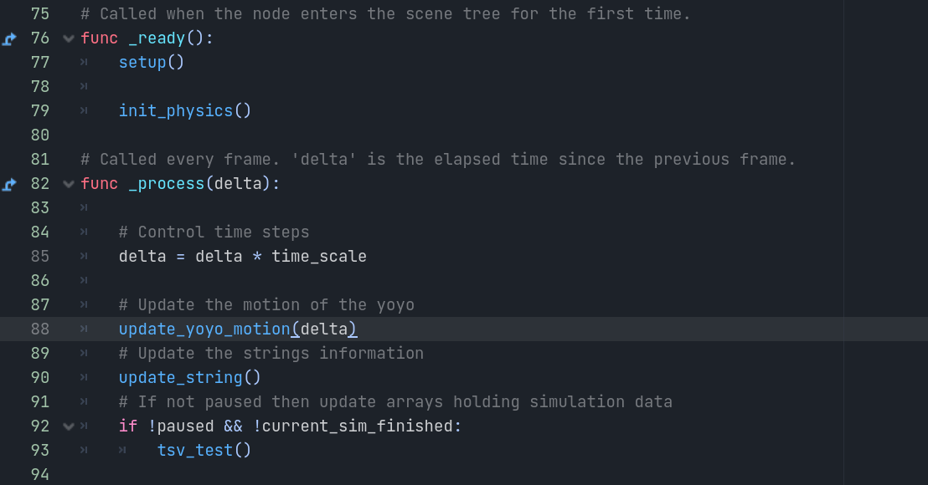
Code Overview: Ready and Process

Slide 26
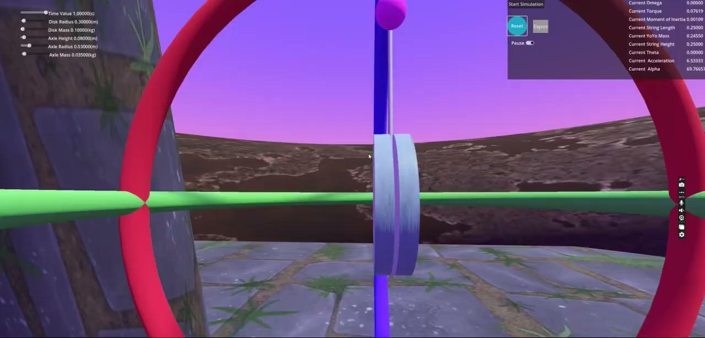
Videos

Slide 27
Videos

Slide 28
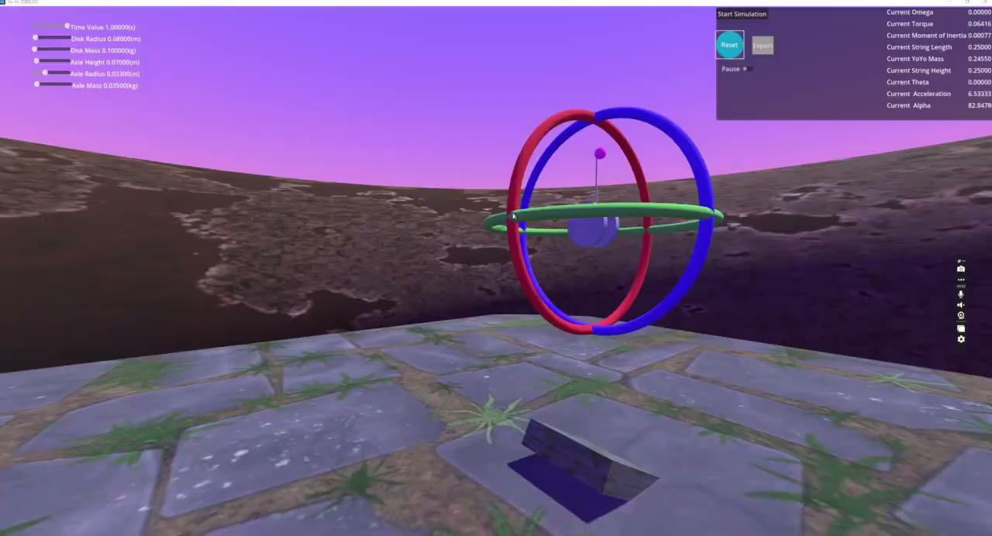
Videos

Slide 29
Conclusions
I found that the axle height and the weight not having an effect on the spin to be surprising.
The radius of the disks, or that of the axle when it is of considerable mass and of relatively similar ratio to the disks, is far more important.
What I would have done differently and/or what I ran out of time while trying to do

Slide 30
Questions on Simulation & Code
Otherwise the end,
Thank you for your time!

